Slide 1
Annual Activities Report
Xxx Club

Slide 2
Event Name: Majlis Peluncuran Jelajah Yakin Anjuran Pejabat Menteri Besar Perak
Date: 22nd April 2026
Time: 2 p.m. - 5 p.m.
Venue: Dewan Banquet, Bangunan Perak Darul Ridzuan
Details: The QSRC members attended the Majlis Peluncuran Bual Bicara Jelajah Yakin, organised by the Unit Komunikasi Strategik Negeri Perak. The event featured YAB Dato’ Seri Saarani Mohamad, Menteri Besar Perak Darul Ridzuan, and served as a platform to highlight state initiatives, promote public engagement, and strengthen awareness of development efforts and assistance programmes introduced for the benefit of the community

Slide 3

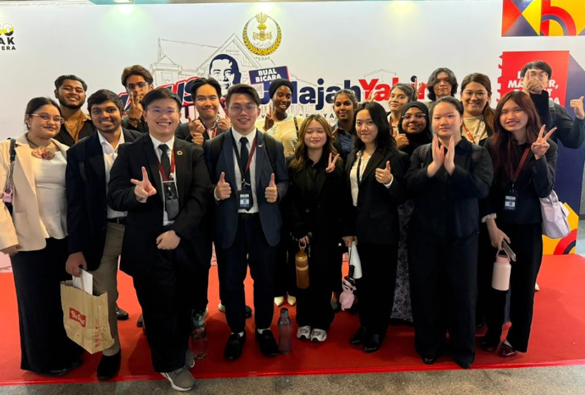
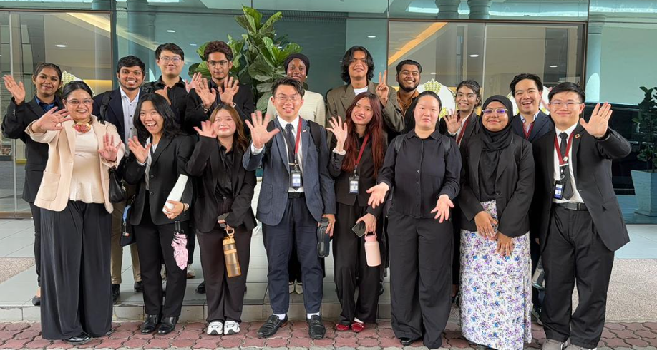

Event Photos

Slide 4
Summary List of Activities
No. | Event Name | Event Date

Slide 5
Event Name:
Date:
Time:
Venue:
Details:

Slide 6
Event Photos

